Slide 1

Self-Guided Tour Booklet

Slide 2
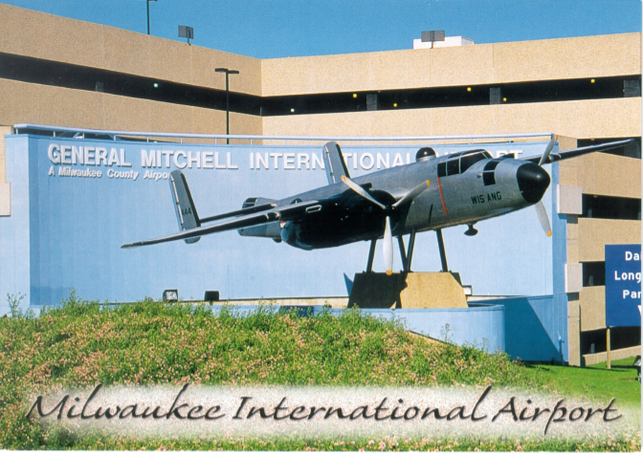
Mitchell B-25
Fun Facts about MKE…
The largest airport in Wisconsin:
2,386 acres
Totally funded by people who use the airport; no property tax dollars are used to support the airport
9 airlines serve Mitchell International
Approximately 135 daily departures
Non-stop flights to 35+ destinations in North America
Easy one-stop connections to 160+ cities worldwide
Upon your arrival, you may have noticed the Mitchell B-25 aircraft. This “Mitchell Bomber” (named after General Billy Mitchell) aircraft memorial is located along the airport entrance next to the parking structure. The plane, a North American B-25 (used in World War II), was restored and donated to Milwaukee’s General Mitchell International Airport by the Wisconsin Air National Guard and the Mitchell Field Rotary Club in 1959. The “Mitchell Bomber” was again restored in 1991 by the Wisconsin Air National Guard.

Slide 3
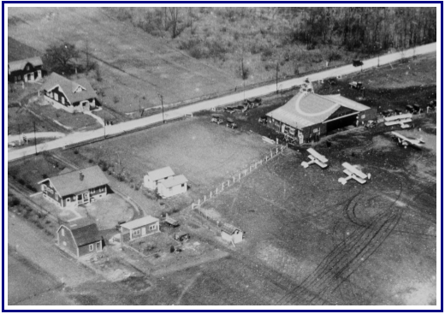
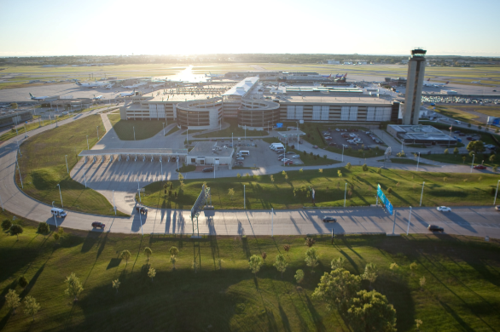
See how we’ve grown…

Slide 4
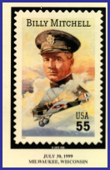
MKE’s Aviation History
Let’s begin our aviation journey with a quick peek at some historical moments here at Mitchell Airport . . .
July 5, 1919 — Milwaukee established the first county-operated airport on the site where Currie Park and Golf Course are now located.
August 27, 1919 — The Lawson Airliner, assembled at the airport, departed on a demonstration flight to the East Coast.
June 7, 1926 — Airmail service began for the Milwaukee area.
It was soon realized that the current airfield was too small but that it couldn’t expand due to a small river that was located to the east and a railroad line that cut through on the west.
October 5, 1926 — the Milwaukee County Board approved the $150,000 purchase of a 163-acre site located in the southeast corner of the county as the site for a new airport facility. It was named Hamilton Airport.
This land was owned by Thomas Hamilton, a local aviator who operated a propeller manufacturing business and small airport. The site included a small wood frame hangar building, which can now be identified by a historical marker near the present location of the fixed base operator (FBO) on East Layton Avenue.
July 1927 — The first airport terminal, the Hirschbuehl Farmhouse, opened on the Hamilton Airport.
July 1927 — Northwest Airways, now known as Northwest Airlines Inc., initiated air service from Milwaukee to Chicago and Minneapolis/ST. Paul
August 20, 1927 — World famous aviator Charles A. Lindbergh visited the Milwaukee Airport.
1938 to July 1940 — A new terminal building was constructed by the Works Progress Administration (WPA). The two-story brick structure was built at a cost of $177,000 and offered a centrally located control tower.
In 1941, the name of the Milwaukee County Airport was changed to “General Mitchell Field” after Milwaukee’s military aviation advocate, Brigadier General “Billy” Mitchell
July 30, 1947 — Milwaukee County, aware of the growth of the general aviation aircraft industry, purchased the Curtiss Wright Airport located in the northwest corner of the county.
1958 — The Curtiss Wright Airport airfield was renamed “Lawrence J. Timmerman Airport,” after county aviation advocate and County Board Chairman Lawrence J. Timmerman.
Early 1950’s — Mitchell Field Airport experienced growth in the number of flight operations, including the large propeller-driven
StratoCruisers and Constellations. Due to congestion at the Layton Avenue terminal building, construction began on a larger terminal facility to be situated on Howell Avenue.
July 19, 1955 — A new three-concourse, two-level structure opened at a cost of $3.2 million. The structure had a capacity of 23 aircraft gates. The airfield then included 1,530 acres of land for runways and taxiways.

Slide 5
MKE’s Aviation History (continued)
July 1961 — Milwaukee entered the “jet age” with the arrival of a Northwest Orient Airlines Boeing 720 four engine jet aircraft (similar to a Boeing 707 jet).
Late 1970’s — Deregulation and continued growth prompted Milwaukee County to begin the renovation of the existing terminal building with new and larger shops and enlarged ticketing and baggage claim areas.
1983 — Mitchell Field entered the “space age” and welcomed Eastern Airlines’ “Spirit of Milwaukee,” an advanced technology Boeing 757 jet aircraft that utilized the same computer system as that of the American Space Shuttle.
In keeping with the international processing facilities at the airport (Customs, Immigration and Agriculture) and its increased national recognition, a new name was also appropriate.
June 19, 1986-the Milwaukee County Board of Supervisors officially changed the name of General Mitchell Field to General Mitchell Int’l Airport
October 1989 — A new Airport Systems Cargo Complex was opened to provide security and ground support services for cargo carriers. The complex also provides services for loading and unloading freight and houses a vehicle maintenance shop, which provides maintenance for ground support equipment.
December 14, 1990 — A 2,250-space parking structure addition was opened to help accommodate the growing demand from travelers.
December 14, 1990 — A new 16-gate expansion of Concourse D opened, bringing Mitchell International’s total number of gates to 42. This included a new 425-foot moving walkway to convey passengers swiftly from the Concourse D entrance to the new gate area.
November 2002 — Another 3,000 space addition to the parking garage opens. Three works of art and 750 ft. moving walkway were installed in the parking structure.
January 2003 — New Rental Car center opens.
October 2004 — New $4.5 Million Ground Run Up Enclosure (GRE) unveiled at GMIA.
December 2004 — Concourse D security checkpoint expanded from two security lanes to six.
January 2005 — Governor Doyle/Senator Kohl dedicate new Airport Amtrak passenger rail station.
October 2005 — GMIA opens new Cellular Phone Waiting Lot.
July 2006 — Concourse C Stem expansion completed.
August 2006 — Concourse E security checkpoint expanded from three lanes to four.
December 2006 — Concourse D stem renovation completed, creating new ground-level boarding gates.
July 2007 — 8 new gates added to Concourse C. Total airport gates = 48.
July 2010- MKE takes ownership of former 440th airlift wing and converts to MKE Regional Business Park
June 2015- Fully remodeled Baggage Claim facility opens.

Slide 6

Parking
Structure
Other parking choices:
Fun Parking Facts…
The parking structure has 6 levels and 35 acres of floor space
Parking stalls are available on a year-round basis
An estimated 7,200 vehicles travel on the terminal drive each day.
Space control system installed to indicate which floors have the most parking spaces available
750ft moving walkway that runs from the west side of the structure to the skywalk leading into the terminal
Hourly parking (first 30 min are free) and Daily parking (longer than five hours and overnight)
  Rule of Thumb: park in Daily (long-term area) if your stay is longer than 5 hours!
Surface lot; first 30 minutes free (outdoor, in walking distance to main terminal)
Cell phone waiting area (outdoor temporary parking;30 spaces available to drivers that are picking up passengers)
Supersaver lot A & B (located west of Howell Avenue; provides nearly 3,000 spaces); long term outdoor parking; free shuttle to and from parking lots to the main terminal in the airport.

Slide 7
Amtrak Station
Fun Facts…
Opened in January 2005
Approximately 1600 square feet, includes heating and a seating area
Is one of four Amtrak stations serving airports in the U.S. The three other airports are Baltimore Washington Int’l, Burbank-Glendale-Pasedena and Newark Liberty Int’l in New Jersey
Increased ridership, setting records over the past few years; 90% on-time performance rate
Parking for 300 vehicles

Slide 8
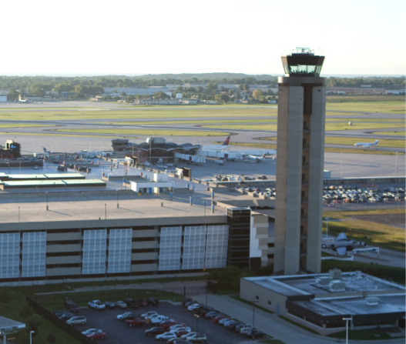
Air Traffic Control Tower
Control Tower Fun Facts...
Height is 200’ 4-1/2” — The same as an 18-story building!
92 modules were used to construct the tower — 23 in each of the 4 legs
Of the tower structure’s four legs:
one contains the elevator — it takes 33 seconds to go from ground level to the tower cab
one contains general utilities
one contains stairs — there are 245 steps from the ground level to the tower cab
one contains electrical powerOn a clear night, you can see the lights of Chicago, Illinois and Muskegon, Michigan
A 200-plus-foot tall air traffic control tower was dedicated on July 7, 1986. The tower is located west of the parking structure and can be easily seen as you approach the Airport.
The Federal Aviation Administration (FAA), an agency of the federal government, operates the tower. The FAA is charged with maintaining the safety of air travel throughout the United States. The tower houses the tower cab (on top), the radar room, electronic equipment rooms and offices.
The radar room controllers interpret numbered blips on a radarscope and perform the critical function of directing aircraft as they approach and depart Milwaukee and other outlying airports within approximately a 30-mile radius and up to 10,000 feet. The controllers in the control tower cab maintain radio contact with pilots, directing those who are operating aircraft within the Mitchell Airport traffic area, and directing other aircraft movement on the ground.

Slide 9
Charter Buses: Drop off passengers on the baggage claim road near door 5.
Tour groups can enter through door 5 (American Airlines).
Upon entering, you will see a set of escalators to your right. Please proceed up the escalator to the main terminal from the baggage claim building. Please meet near the Traveler’s Aid Information Desk.
If anyone from your tour group requires an elevator from the baggage claim building to the main terminal, the elevator is located immediately across from the escalators. Take the elevator to level 3 skywalk and proceed to the main terminal. Please meet near the Traveler’s Aid Information Desk.
A great place to begin your tour: The Mitchell Gallery of Flight! Please ask the volunteers at the Info Desk to point you in the right direction.
Let’s Begin!

Slide 10
The Tour
General Mitchell International Airport

Slide 11
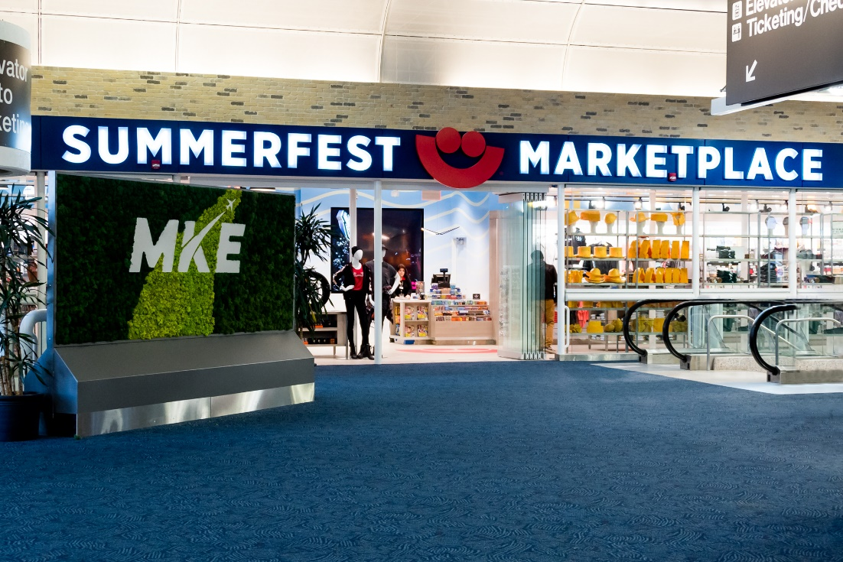
Tour: Main Terminal - Upper Level (north end)
Please start at the Summerfest Marketplace, which is the only Summerfest retail location outside of the festival grounds. It has a Wisconsin team apparel, a nice children’s section, and a wide variety of locally made gifts. During the winter season, it also operates the only coat check service at any major airport in the United States.

Slide 12
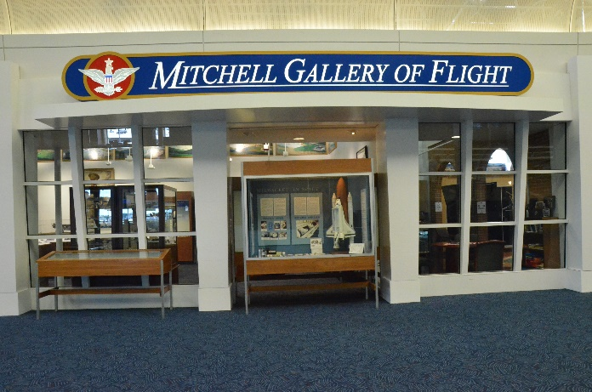
Tour: Main Terminal Area- Upper Level (south end)
Please start at the Mitchell Gallery of Flight, see the history of aviation!
The Mitchell Gallery of Flight, an aviation museum, is located near Concourse C in the concession mall. It features displays and exhibits unique to local aviation history. The 24’ x 60’ Gallery provides air travelers and visitors alike with a unique and informative aviation experience. A non-profit organization, the Friends of the Mitchell Gallery of Flight, plans the displays, directs display programs, fundraisers, and membership activities. You can share in retaining the rich aviation heritage unique to Milwaukee. Various levels of membership in the Friends of the Mitchell Gallery of Flight are available. For questions or additional information, please call or write:
Friends of the Mitchell Gallery of Flight
General Mitchell International Airport
5300 South Howell Avenue
Milwaukee, WI 53207
414-747-5300

Slide 13
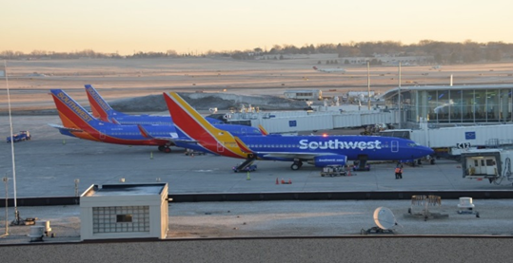
The Tour (cont’d)…
Across from the Summerfest Marketplace, you will see the PGA Tour Shop, Spanx, and No Boundaries. Lots of goodies to purchase!
Walking northwest from the escalator, look out the windows on the way to the Concourse C entrance. Aircraft can often be seen parked here. Before departure, aircraft are refueled and restocked with food and beverages, airline personnel clean and inspect the plane, baggage and/or freight are loaded and unloaded, and lavatories are serviced.
Please head toward the down escalators near the Summerfest Marketplace.

Slide 14
Tour: Take the Elevator down to Ticketing- located right outside of the Summerfest Marketplace.
You will see all the airlines that service passengers at MKE. The airlines have designated ticket counters for their passengers to check in for their flight and to weigh their luggage so that it can be placed in the belly of the airplane. Passengers can also purchase tickets and make reservations for future flights. Arrangements can be made for the handling of pets, odd-sized baggage, skis, bicycles or other “unusual” items passengers wish to take with them on their trip.
Directly opposite of the counters are monitors which display flight information and tourist destinations, along with self check-in machines for passengers who would like to check-in and print their own boarding pass.
In this area you will find skycap service. Skycaps assist passengers with luggage and wheelchair service.
Please head to the south end of ticketing to the last escalator and proceed up.

Slide 15
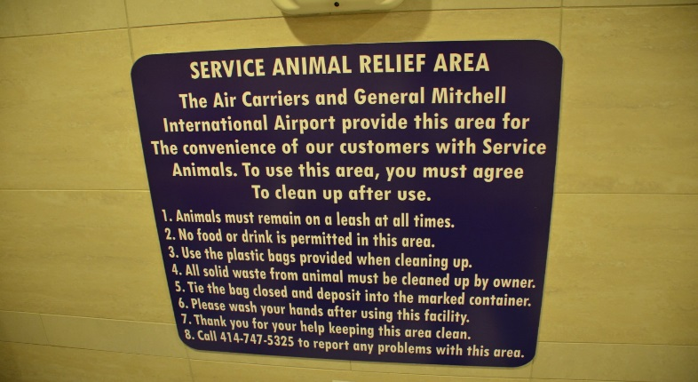
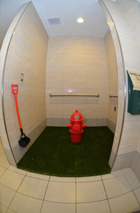
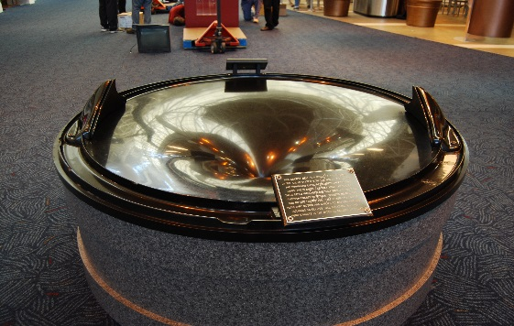
Main Terminal Area- Upper Level (south end)
At the south end of the main terminal, you will find an area with picnic tables promoting the Milwaukee County Parks. There are also some flight information displays showing arriving and departing flights.
Across from the family restroom, you will see our indoor Service Animal Relief Area.
Hope you brought your coins!!! The Gravity Well is a display of centrifugal force in which a coin is launched and travels in smaller and smaller, faster and faster circles until it is drawn into the center of the well. This is located near the Mitchell Gallery of Flight. The coins that are collected help fund the Gallery.
You will also see a Mamava lactation station for mothers who wish to nurse in private.

Slide 16
Main Terminal Area- Upper Level (south end) continued.
You will see:
To the right of the Gallery of Flight, you will see the USO Lounge for traveling military, Renaissance Books, Miller Brewery Shop. On the other side, the MKE Streetside Café and the Miller Brewhouse.
Parade of Planes Display – Glass display of airplane models.
Milwaukee Clock (look ahead and up)- the old-fashioned four-sided clock hanging in the center of the main concession mall near the Travelers Aid desk is a replica made especially for the airport. Clocks in this style graced the city during the late 1800s. The airport serves as a gateway to and first impression of Milwaukee for many visitors, so we proudly display this example of the region’s architectural heritage.
Airport Information Desk-The counter for Travelers Aid is located in the center of the concession mall. The volunteers strive to assist travelers, visitors, and the general public with information about flights, the city and airport. Volunteers make announcements over the paging system, answer the telephone, record and retrieve lost and found items, use the computer for flight information, provide information on transportation, hotels, dining, shopping, area events, and points of interest, and assist in mailing items that do not pass security regulations. The desk is staffed from 5 a.m. to 12 a.m.

Slide 17
Main Terminal Area- Upper Level (middle)
You will see (con’t):
Starbucks Coffee- Stop and get a cup of your favorite flavor and have a snack!
Flightview – MKE Arrivals Screen (North of information desk) This bank of screens is another source of flight information for both travelers and for those waiting for flights to arrive. These screens allow travelers to watch the radar positions of in-flight airplanes scheduled to arrive at MKE. Three of the four screens focus on a region of the country with the fourth screen showing the entire country. Another interesting feature of the screens is that they also display current weather systems throughout the country.
Curtis 1911 Pusher (look up)-This airplane, located in the concession mall near the entrance to the Brooks Brothers store, reflects the aviation history of Milwaukee and southeastern Wisconsin. It is an authentic reproduction of the type of airplane owned and flown by Milwaukee’s first pilot, John Kaminski. Waukesha residents Dale and Dean Crites built this airplane replica in 1974. The plane has been flown in many air shows and events, including the annual EAA AirVenture Oshkosh.
Communities Mosaic of Culture - Over 700 Milwaukee Public School third graders created the “Communities Mosaic of Culture” murals located within the concession mall at the entrance to the center skywalk. The mosaics are the result of a literacy program, sponsored by We Energies, that uses art, history, and visual artists to encourage students to research, read, write and present. Students worked with professional artists to develop their ideas and drawings. The murals consist of thousands of buttons, beads, and various odds and ends to create the colorful collage.

Slide 18
Concourses C, D and E
Where is concourse A & B? Initially, concourses C, D and E were created with the intent to create A & B, for a total of five concourses. Signage went up to identify concourses C, D and E. Later, decisions were made to not add concourses A & B. Instead of renaming concourses A, B and C, they remained unchanged as C, D and E, since signage was already in place.
Due to increased security, you are no longer able to walk through the security checkpoint without a boarding pass. Upon entering any of the three concourses- C, D or E, passengers must pass through a screening device as required by federal law. Parcels, purses and any carry-on baggage must be inspected by an X-Ray machine operated by the Transportation Security Administration (TSA) personnel. People must also walk through a metal detector or body scanner. Selected bags may be hand-searched. Each of the three concourses has a gift shop, a snack/bar or eat-in restaurant. The airline gate holding areas have seating available for those passengers waiting to board. Airline representatives at these holding areas assist passengers in the boarding process.

Slide 19
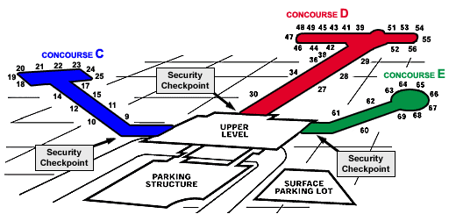
Concourses C, D & E
Concourse C Concourse D Concourse E
Air Canada Alaska (closed)
Southwest American
United Contour
Delta
Frontier
JetBlue
Spirit
Sun Country

Slide 20
Concourse C: Airport Administration and International Arrivals Terminal
Administration Building
The offices and facilities of the Airport Administration, Maintenance and Engineering staffs are located in a wing just off Concourse C prior to the security-screening checkpoint. These employees manage the day-to-day activities at General Mitchell International Airport and those at Lawrence J. Timmerman Airport, which serves smaller aircraft.
International Arrivals Terminal
Visible to the west of Concourse C is the International Arrivals Terminal, which serves primarily as a gateway for travelers arriving from cities outside of the United States. This building contains the offices and screening facilities of U.S. Customs and Border Protection. Up to 300 returning international passengers can be processed per hour at this facility.

Slide 21
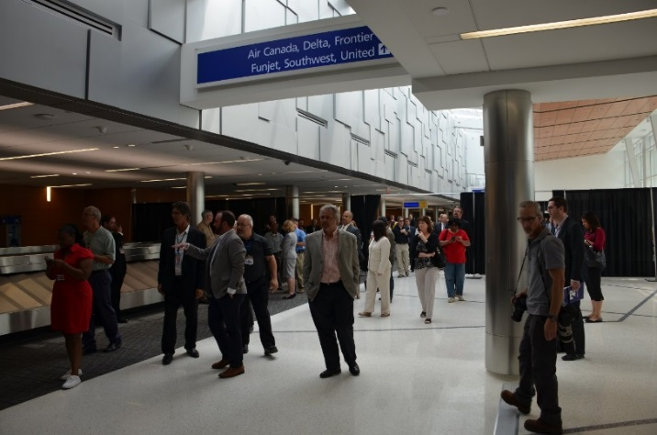
Where Do Travelers Pick Up Luggage?
(Please head toward No Boundaries and take escalator down to baggage claim).
BAGGAGE CLAIM BUILDING
Incoming baggage from aircraft is unloaded to airline baggage carts and then distributed onto one of the five baggage belts. Monitors in the claim areas provide information for the retrieval of bags.
Services found in this area include:
Airline baggage service offices, direct line hotel telephones, visitor information, and an airport ambassador to assist in providing ground transportation to deplaning passengers. Feel free to walk around to view the hanging artwork and wall décor.
.

Slide 22
Baggage Claim (End of tour)
Feel free to explore the baggage claim building
Charter buses should be waiting outside of Door 5
Thank you for touring the airport and we encourage you to come back to check us out! ;)

Slide 23
The Airfield
The airfield is the largest part of the airport and consists of all the runways, taxiways, perimeter roadways and holding areas for aircraft. Paint markings, lighting and navigational aids are used in combination to assist a smooth flow of traffic on the airfield. Paint markings and lighting vary with color. White paint is used on the runways and yellow is used on the taxiways and on the terminal ramp to indicate aircraft parking areas. Runways or taxiways have centerline, distance and holding markings. Airfield lighting is also color-coded, with runway lights white, taxiway lights blue and threshold lights green or red. All of these lights can be adjusted for high, medium or low intensity by air traffic controllers in the control tower.
There are many kinds of navigational aids at the airport. Approach lighting, located at the end of the primary runways, is used by a pilot for landing reference. Because aircraft must fly into the wind, the airfield windsock is used to indicate wind direction and speed, which helps to determine which runway is to be used during takeoffs and landings.
The primary runways use an Instrument Landing System (ILS), which assists approaching pilots landing in bad weather or in poor visibility.
This system consists of a: Marker Beacon, which tells the pilots how far out they are from the end of the runway.
Glide Slope, which tells the pilots if they are too low or high during the landing approach.
Localizer, which tells the pilots if they are too far to the left or right in approaching the runway.
There are five runways at General Mitchell International Airport, ranging in size from 10,000 feet long (a little less than two miles) and 200 feet wide, to the shortest runway of 3,500 feet long (about two-thirds of a mile long). There is a total of 144 miles of taxiways. The primary ILS runways have a grooved surface that reduces the possibility of an aircraft hydroplaning on a wet runway surface.
The airport’s ramps and runways can accommodate large aircraft such as the Boeing 747. The surfaces of ramps and runways are strong and thick enough to withstand such aircraft weight.

Slide 24
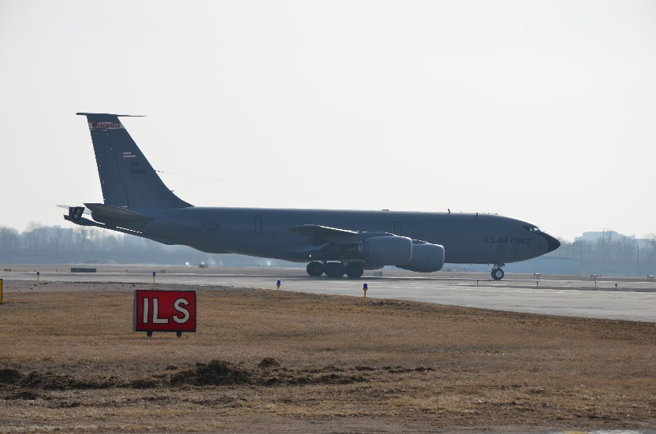
128th Wisconsin Air National Guard
(located on the eastern edge of airport)
Wisconsin Air National Guard
The 128th Wisconsin Air National Guard(ANG) Air Refueling Squadron Base, located on the eastern edge of the airport, maintains and operates the KC-135 aircraft. The KC-135 is the military version of the Boeing 707 jet. Specially equipped, this jet can complete inflight refueling to other military aircraft by using an extended boom from the KC-135 tanker. Fighter aircraft in-flight refueling activities are coordinated and monitored by the Tactical Control Flight Facility. Military flight activities such as these are conducted within a restricted area.

Slide 25
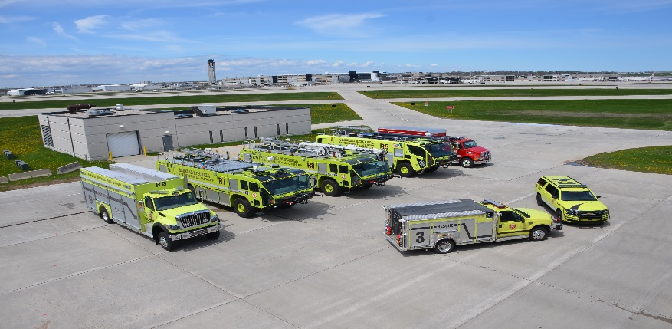
AIRPORT FIRE STATION (located on the southeastern part of the airport)
Airport Fire Station
The fire station, visible from the gates on the south end of Concourse E, is centrally located on the airport to provide crash/fire rescue vehicles ready access to the runways and taxiways. The station is staffed 24 hours a day by firefighters who respond to emergencies and operate the specialized vehicles. Firefighters are required by federal regulations to be on the scene of an accident anywhere on the airfield within three minutes. These sophisticated radio-equipped vehicles are capable of fighting aircraft, fuel or structural fires. The larger fire trucks carry a total of 5,000 gallons of water that when combined with chemicals produce fire suppressant foam. Other vehicles at the fire station respond to medical emergencies at the Airport. Additional firefighting assistance and vehicles are available through a mutual aid fire protection agreement with the military bases adjacent to the Airport and with nearby communities.

